Slide 1
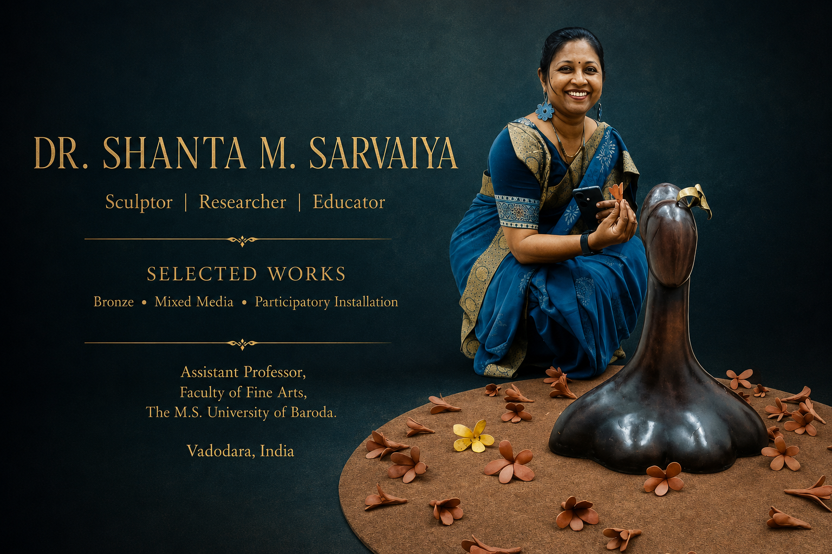

Slide 2
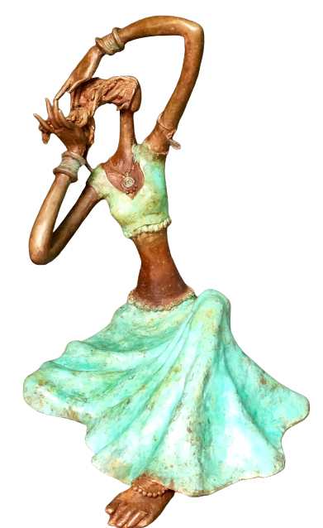
ARTIST STATEMENT
Material, Memory and transformation
The human figure has remained central to my work. Rather than representing the body as a fixed form, I see it as a vessel of experience-one that embodies memory, emotion, vulnerability, and strength. My elongated figures, often inspired by women, evoke quiet contemplation, grace, and endurance. They celebrate womanhood not as an idealized image but as a living force that nurtures, transforms, and sustains. Through subtle gestures, movement, and balance, these sculptures invite viewers to reflect on their own emotional and cultural experiences.
Nature is another enduring source of inspiration. Series such as Ode to Nature, Kalpavruksha, and Sanjeevni explore the interconnectedness of human life and the natural world, reminding us that both flourish through care and coexistence. My recent works extend this dialogue by addressing biodiversity, ecological fragility, and environmental responsibility through sustainable materials and participatory approaches.

Slide 3
Artist Biography
Dr. Shanta Sarvaiya ( Samanta)(b. 1975) is an Indian sculptor and Assistant Professor in the Department of Sculpture at the Faculty of Fine Arts, Maharaja Sayajirao University of Baroda, India. Working primarily in bronze and mixed media, her practice explores memory, transformation, materiality, and the body as a site of lived experience. Through sculpture and participatory installations, she investigates how everyday objects and humble materials can embody collective histories, cultural narratives, and evolving relationships between people, place, and memory.
She studied Creative Sculpture at the Faculty of Fine Arts, Maharaja Sayajirao University of Baroda, where she completed her Bachelor's degree and earned a First Class Master's degree in 2001. She later completed her Ph.D. in Sculpture from the same institution. Alongside her studio practice, she is actively engaged in research, teaching, and mentoring emerging artists.
Sarvaiya is the recipient of the National Cultural Scholarship (2000–2002) and the Lalit Kala Akademi Scholarship (2003–2004). Her work has received several honours, including the AIFACS Award, New Delhi (1998), the AIFACS Millennium All India Art Award, Ahmadabad (2000), and the Gujarat State Lalit Kala Akademi Awards (1999 and 2002).
She has presented four solo exhibitions at Bajaj Art Gallery, Mumbai (2001); Contemporary Art Gallery, Ahmadabad (2002); Marvel Art Gallery (2007); and Cymroza Art Gallery, Mumbai (2008). Her work has also been exhibited at major art fairs and exhibitions, including India Art Fair, Dubai Art Fair, and Singapore Art Fair, among others. Her sculptures are part of public and private collections in India and internationally

Slide 4
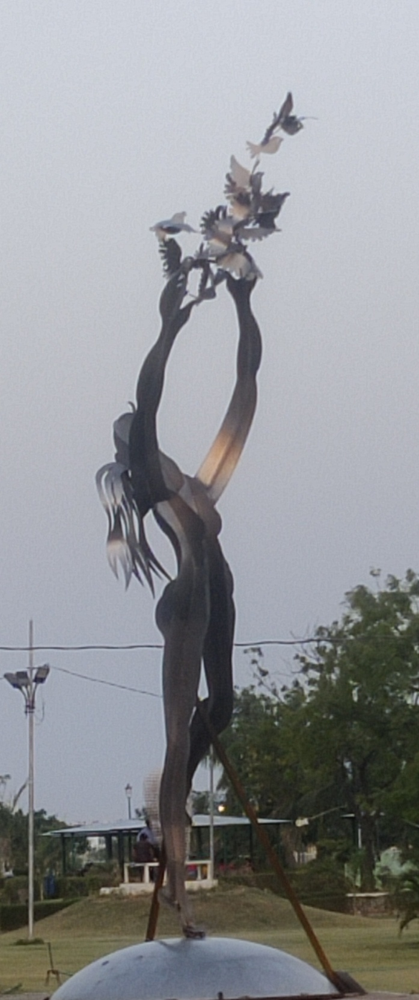
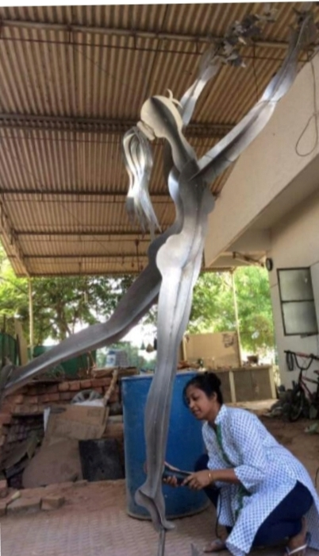
Freedom
“Freedom” is a monumental stainless-steel sculpture at a Sculpture Park near Vadodara Airport, Gujarat. A woman releases birds into the open sky, symbolizing resilience, dreams, and liberation. Reflecting the changing sunlight, the steel surface creates an ever-shifting visual experience. The sculpture celebrates women who courageously break free from constraints and pursue their dreams with determination.
Against the backdrop of the open sky, "Freedom" encapsulates the essence of liberation, both figuratively and literally. The sculpture serves as a visual ode to the indomitable spirit of women who dare to dream, breaking free from constraints and societal expectations.
Title: Freedom
Medium: Stainless Steel
Dimension: 15 x 8 x 7 (feet)
Year: 2017

Slide 5
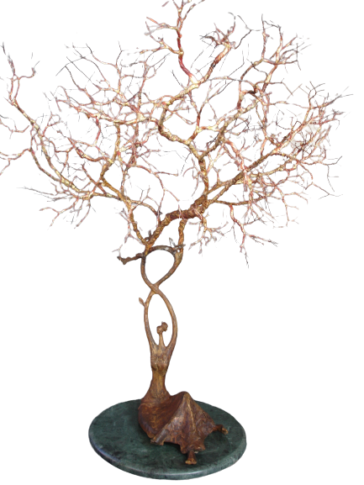
An Ode to Nature
In this work, the female form transforms into a flourishing tree—rooted in resilience, adorned with leaves, flowers, and birds.
Cast in bronze, these works evoke the mythical wish-fulfilling tree while reflecting women’s enduring roles as nurturers, protectors, and providers of love and shelter. The series celebrates their strength, generosity, and profound connection with nature.
Title: Ode to Nature
Medium: Bronze, brass and copper
Dimension: 29 x 27 x 26 ( inches)
Year: 2017

Slide 6
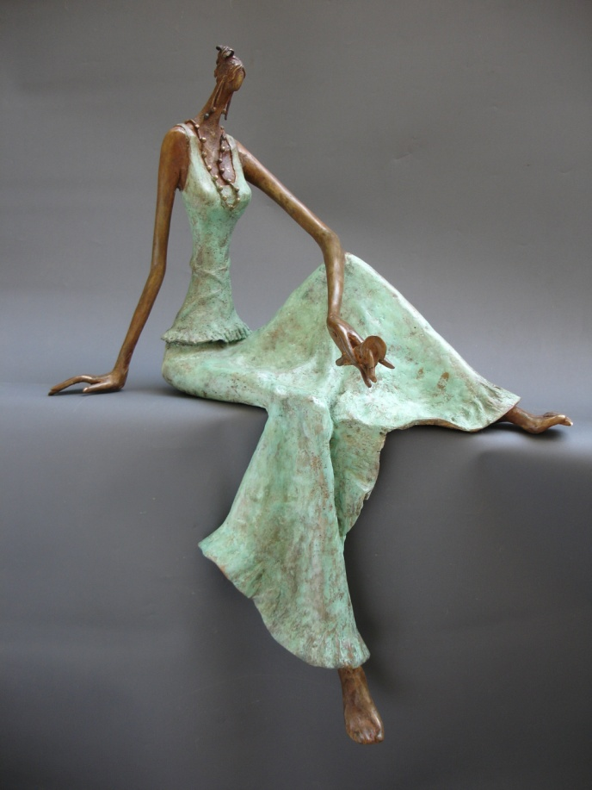
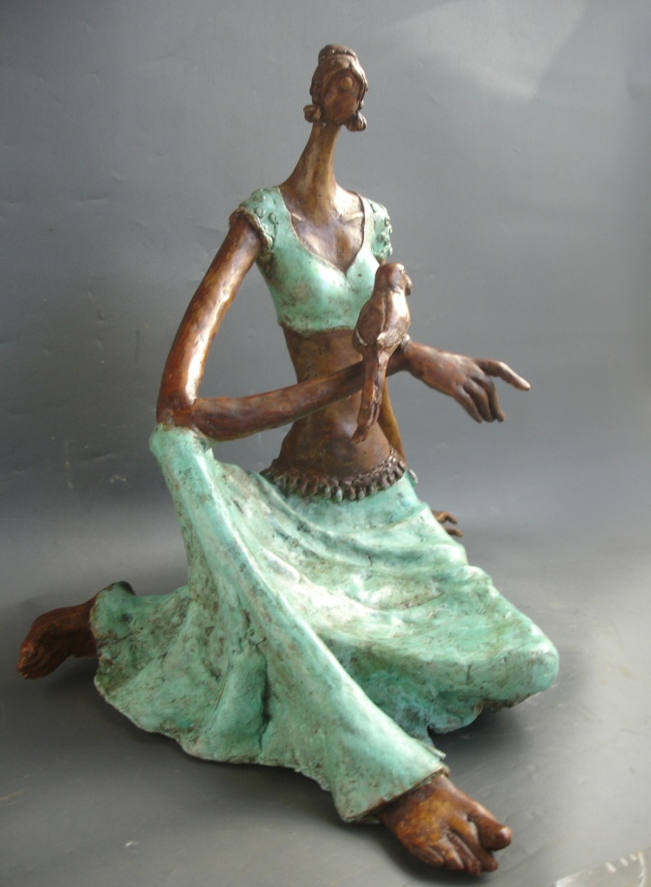
The Shringar Series explores slender, elongated female figures in bronze, capturing the graceful transition into adulthood. Portrayed in intimate moments of self-adornment, the sculptures celebrate feminine beauty, confidence, and grace.
Through poised gestures and fluid forms, the series reflects the delicate interplay of innocence, sensuality, self-discovery, and the timeless celebration of the feminine spirit.
Title:
Medium:
Dimension:
Year:
Title:
Medium:
Dimension:
Year:

Slide 7
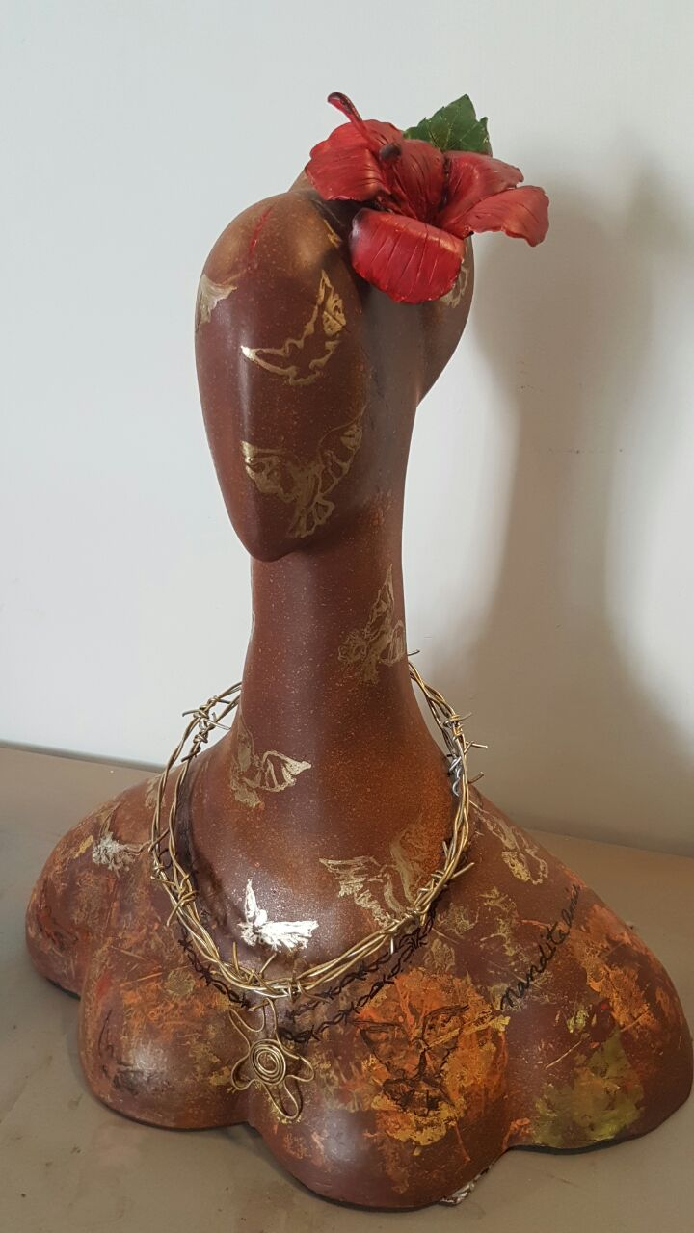
Shackled explores the complex dynamics of contemporary relationships, portraying a woman whose beauty and adornment conceal an invisible burden. A diamond necklace transforms into barbed wire, with a pendant bearing the artist’s thumbprints becoming a symbol of possession and confinement. The work questions how affection can become control, reducing women to objects of status, pride, and patriarchal authority.
Title: Shackled
Medium: Epoxy Resin
Dimension: 2 feet x 2 feet x 1 foot
Year: 2018

Slide 8
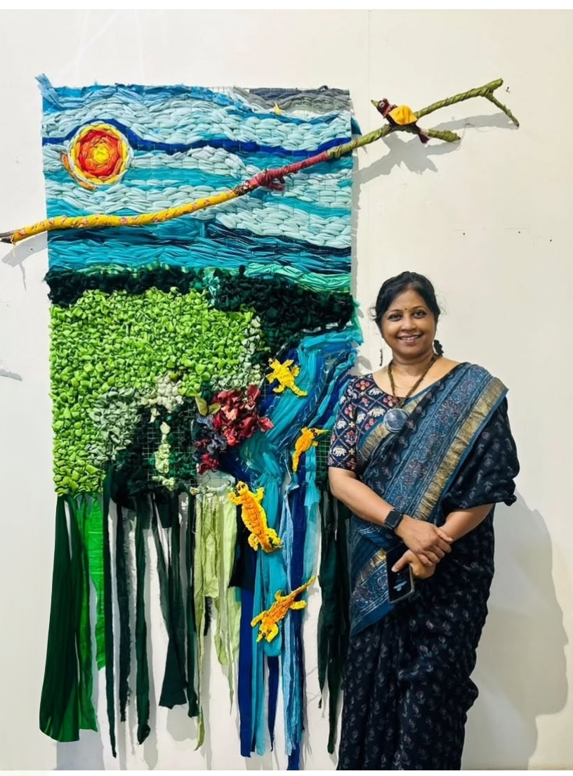
LIVING TAPESTRY
This artwork celebrates the interconnectedness of all life. Birds, flora, fauna, and even the crocodile are shown as vital threads in nature's fabric, reminding us to respect and protect the delicate balance of biodiversity.
Materials that have been discarded are given a new life, echoing nature’s own cycles of regeneration and interdependence. The work invites us to look beyond individual forms and recognize the fragile connections that sustain life.
Title: LIVING TAPESTRY
Medium: Textile waste
Size: 2 feet x 3 feet

Slide 9
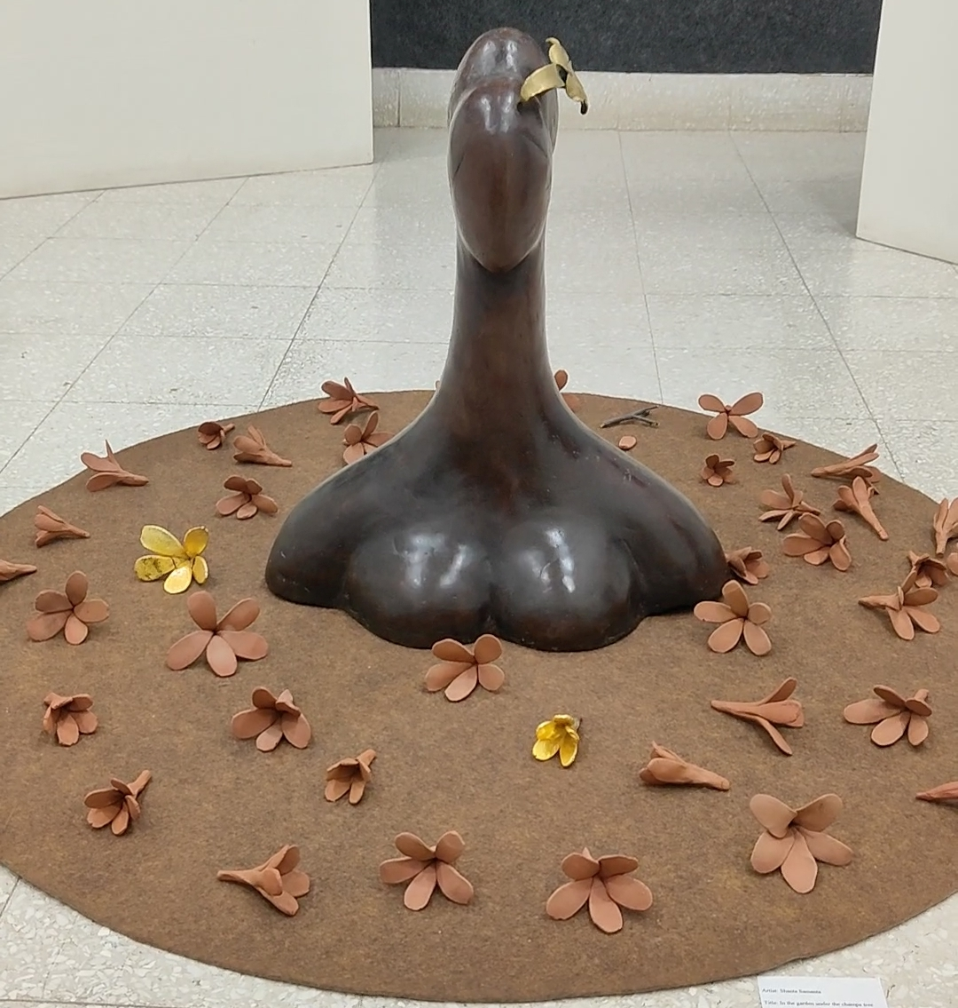
A Floral Symphony
A poetic tribute to the cherished sanctuary of my garden, where a bronze figure rests among terracotta flowers. Inspired by dawn rituals—the chirping birds, rustling leaves, and fragrant ivory champa blossoms—the work evokes memories of quiet mornings spent reclining among petals, immersed in nature’s timeless serenity.
Medium : Bronze, terracotta
Size : 2 feet x 4 feet x 4 feet

Slide 10
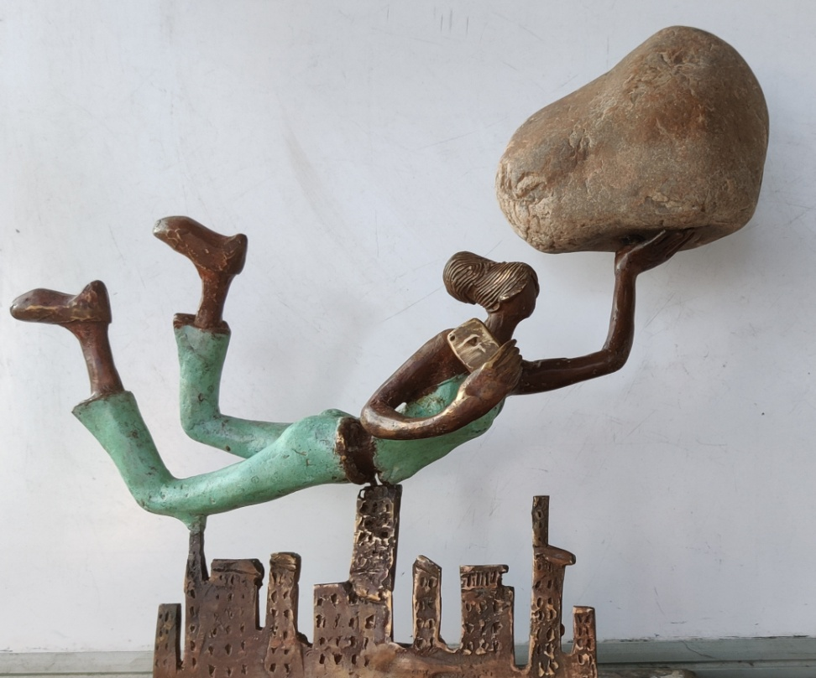
In this sculpture a female figure is shown flying over a cityscape with a mountain in one hand and a mobile in the other hand. Here I have emphasized today's women in multi tasking roles, rushing through each day to meet the demands of her home family and friends. Sometimes she too faces the life saving situations where she has to take up uphill tasks, the mountain in her one hand represents the mountain of responsibilities while the mobile in the other hand represents the modern tool to meet the demands of her workplace and so she has to always remain 'available' and 'connected' to her family, friends and colleagues and world at large in the urban setup where multitasking activities are part of a daily life in today's reality.
Titled: Sanjeevani- An Endless journey
Medium: Bronze

